Slide 1

Presented by: Name: Sajan Kumar Skillbuild Email Id: sajankumarsingh003@gmail.com College Name: C.V. Raman Global University Bhubaneswar Odisha College State: Odisha Internship Starting Date: 24-06-2024 Internship End Date: 31-07-2024
“ONLINE VOTING SYSTEM”

Slide 2
OUTLINES
Problem Statement
System Overview
User Authentication
Voting Process
Database Schema
Security Measures
Results
Benefits
Conclusion
Future Enhancements
References

Slide 3
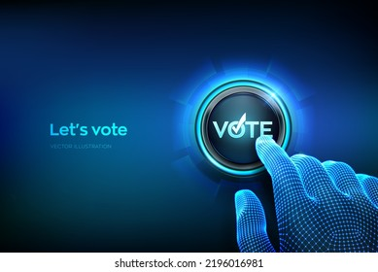
Introduction
Welcome to our presentation on the Voting Management System, a comprehensive solution designed to streamline the voting process, ensure security, and maintain transparency. This system aims to revolutionize the way we conduct elections, providing an efficient and reliable platform for citizens to exercise their democratic rights.

Slide 4
System Overview
Login Page
1
The system begins with a secure login page where users enter their credentials. This initial step ensures that only authorized individuals can access the voting platform.
2
Authentication
Upon submitting their login details, the system validates the user's credentials against the database. If the authentication is successful, the user is granted access to the voting page.
Voting Page
3
On the voting page, users can view the list of candidates and cast their vote by selecting their preferred choice. The system ensures that each user can vote only once, preventing any attempts at duplicate voting.
4
Thank You Page
After successfully casting their vote, users are redirected to a thank you page, acknowledging their participation in the democratic process. They can then log out of the system securely.

Slide 5
User Authentication
Secure Login
Database Validation
Session Management
The login page serves as the gateway to the voting system, ensuring that only authorized individuals can access the platform. Users are required to enter their unique username, which is validated against the database to prevent unauthorized access.
The system employs a robust database to store user information and voting records. When a user attempts to log in, their credentials are cross-checked against the database to verify their authenticity. This step is crucial in maintaining the integrity of the voting process.
Once a user is successfully authenticated, the system creates a secure session to track their activity. This session management ensures that only authorized users can access the voting page and prevents any attempts at unauthorized access or manipulation.

Slide 6
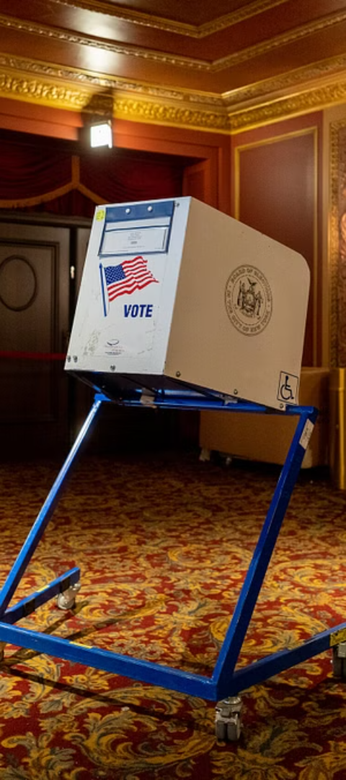



Voting Process
Candidate Selection
On the voting page, users are presented with a list of candidates or options. They can carefully review the choices and select their preferred candidate by clicking the corresponding radio button.
Database Update
Once the user submits their vote, the system updates the database to record their choice. This step is crucial in ensuring the accuracy and transparency of the voting process.
Prevention of Multiple Votes
The system is designed to prevent users from casting multiple votes. After a user has successfully voted, their record in the database is updated to reflect that they have already participated in the election.

Slide 7
Database Schema
Field
Type
Description
id
INT
Unique identifier for each voter
username
VARCHAR(50)
Unique username for each voter
voted
VARCHAR(50)
Indicates whether the user has voted or not
The Voting Management System utilizes a MySQL database to store and manage voter information. The database consists of a single table named "Voters" with three fields: id, username, and voted. The id field serves as a unique identifier for each voter, while the username field stores the unique username for each voter. The voted field is a boolean field that indicates whether the user has already cast their vote or not.

Slide 8

Security Measures
1
Prepared Statements
2
Session Management
To prevent SQL injection attacks, the system employs prepared statements when interacting with the database. This approach ensures that user input is properly sanitized and validated, reducing the risk of malicious code execution.
The system implements robust session management to track user activity and prevent unauthorized access. Each user's session is securely managed, ensuring that only authenticated users can access the voting page and cast their vote.
3
Unique Username Constraint
The database enforces a unique constraint on the username field, preventing duplicate usernames from being registered. This measure helps maintain the integrity of the voting process by ensuring that each user can only vote once.

Slide 9
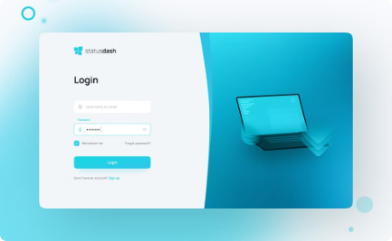
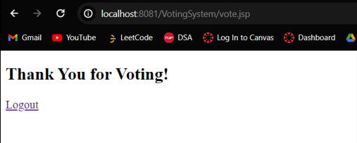
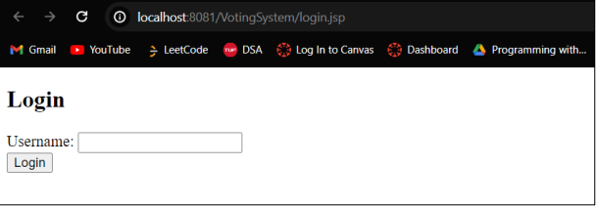
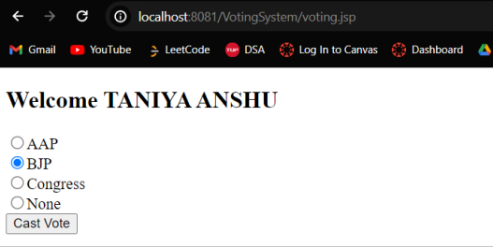
Results
Login Page
Voting Page
Thank You Page
Users begin by entering their credentials on the secure login page. The system validates their username against the database to grant access.
Once authenticated, users are directed to the voting page, where they can review the list of candidates and cast their vote by selecting their preferred choice.
After successfully casting their vote, users are redirected to a thank you page, acknowledging their participation in the democratic process. They can then log out securely.

Slide 10



Benefits
Efficiency
Transparency
Security
The Voting Management System streamlines the voting process, reducing the time and effort required to conduct elections. It eliminates the need for manual vote counting and ensures accurate and timely results.
By maintaining a secure database and implementing robust security measures, the system ensures transparency throughout the voting process. Voters can have confidence in the integrity of the results.
The system prioritizes security by employing various measures such as prepared statements, session management, and unique username constraints. These measures protect against potential threats and ensure the confidentiality of voter information.

Slide 11
Future Enhancements
Multi-Factor Authentication
Mobile Compatibility
To further enhance security, the system could implement multi-factor authentication, requiring users to provide additional verification methods beyond just a username and password.
Developing a mobile-friendly version of the system would increase accessibility and convenience for voters, allowing them to cast their votes from their smartphones or tablets.
Audit Trail
Multilingual Support
Implementing an audit trail feature would provide a detailed log of all activities within the system, enabling administrators to monitor and review the voting process for any irregularities or potential issues.
To cater to a diverse population, the system could be enhanced to support multiple languages, ensuring that voters can participate in the process regardless of their native language.

Slide 12
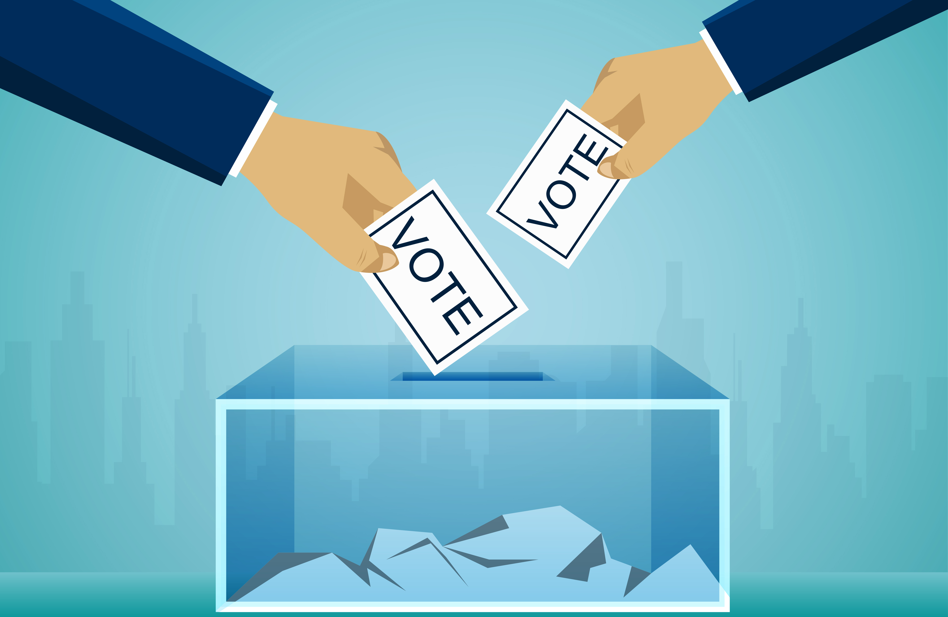
Conclusion
The Voting Management System represents a significant step forward in conducting secure, transparent, and efficient elections. By leveraging modern technology and implementing robust security measures, this system ensures that every vote counts and that the democratic process is upheld with integrity.
Through its user-friendly interface, secure authentication, and prevention of duplicate voting, the system empowers citizens to exercise their right to vote with confidence.
As we continue to enhance and refine this system, we remain committed to staying at the forefront of voting technology, ensuring that the democratic process remains accessible, secure, and reliable for generations to come.

Slide 13
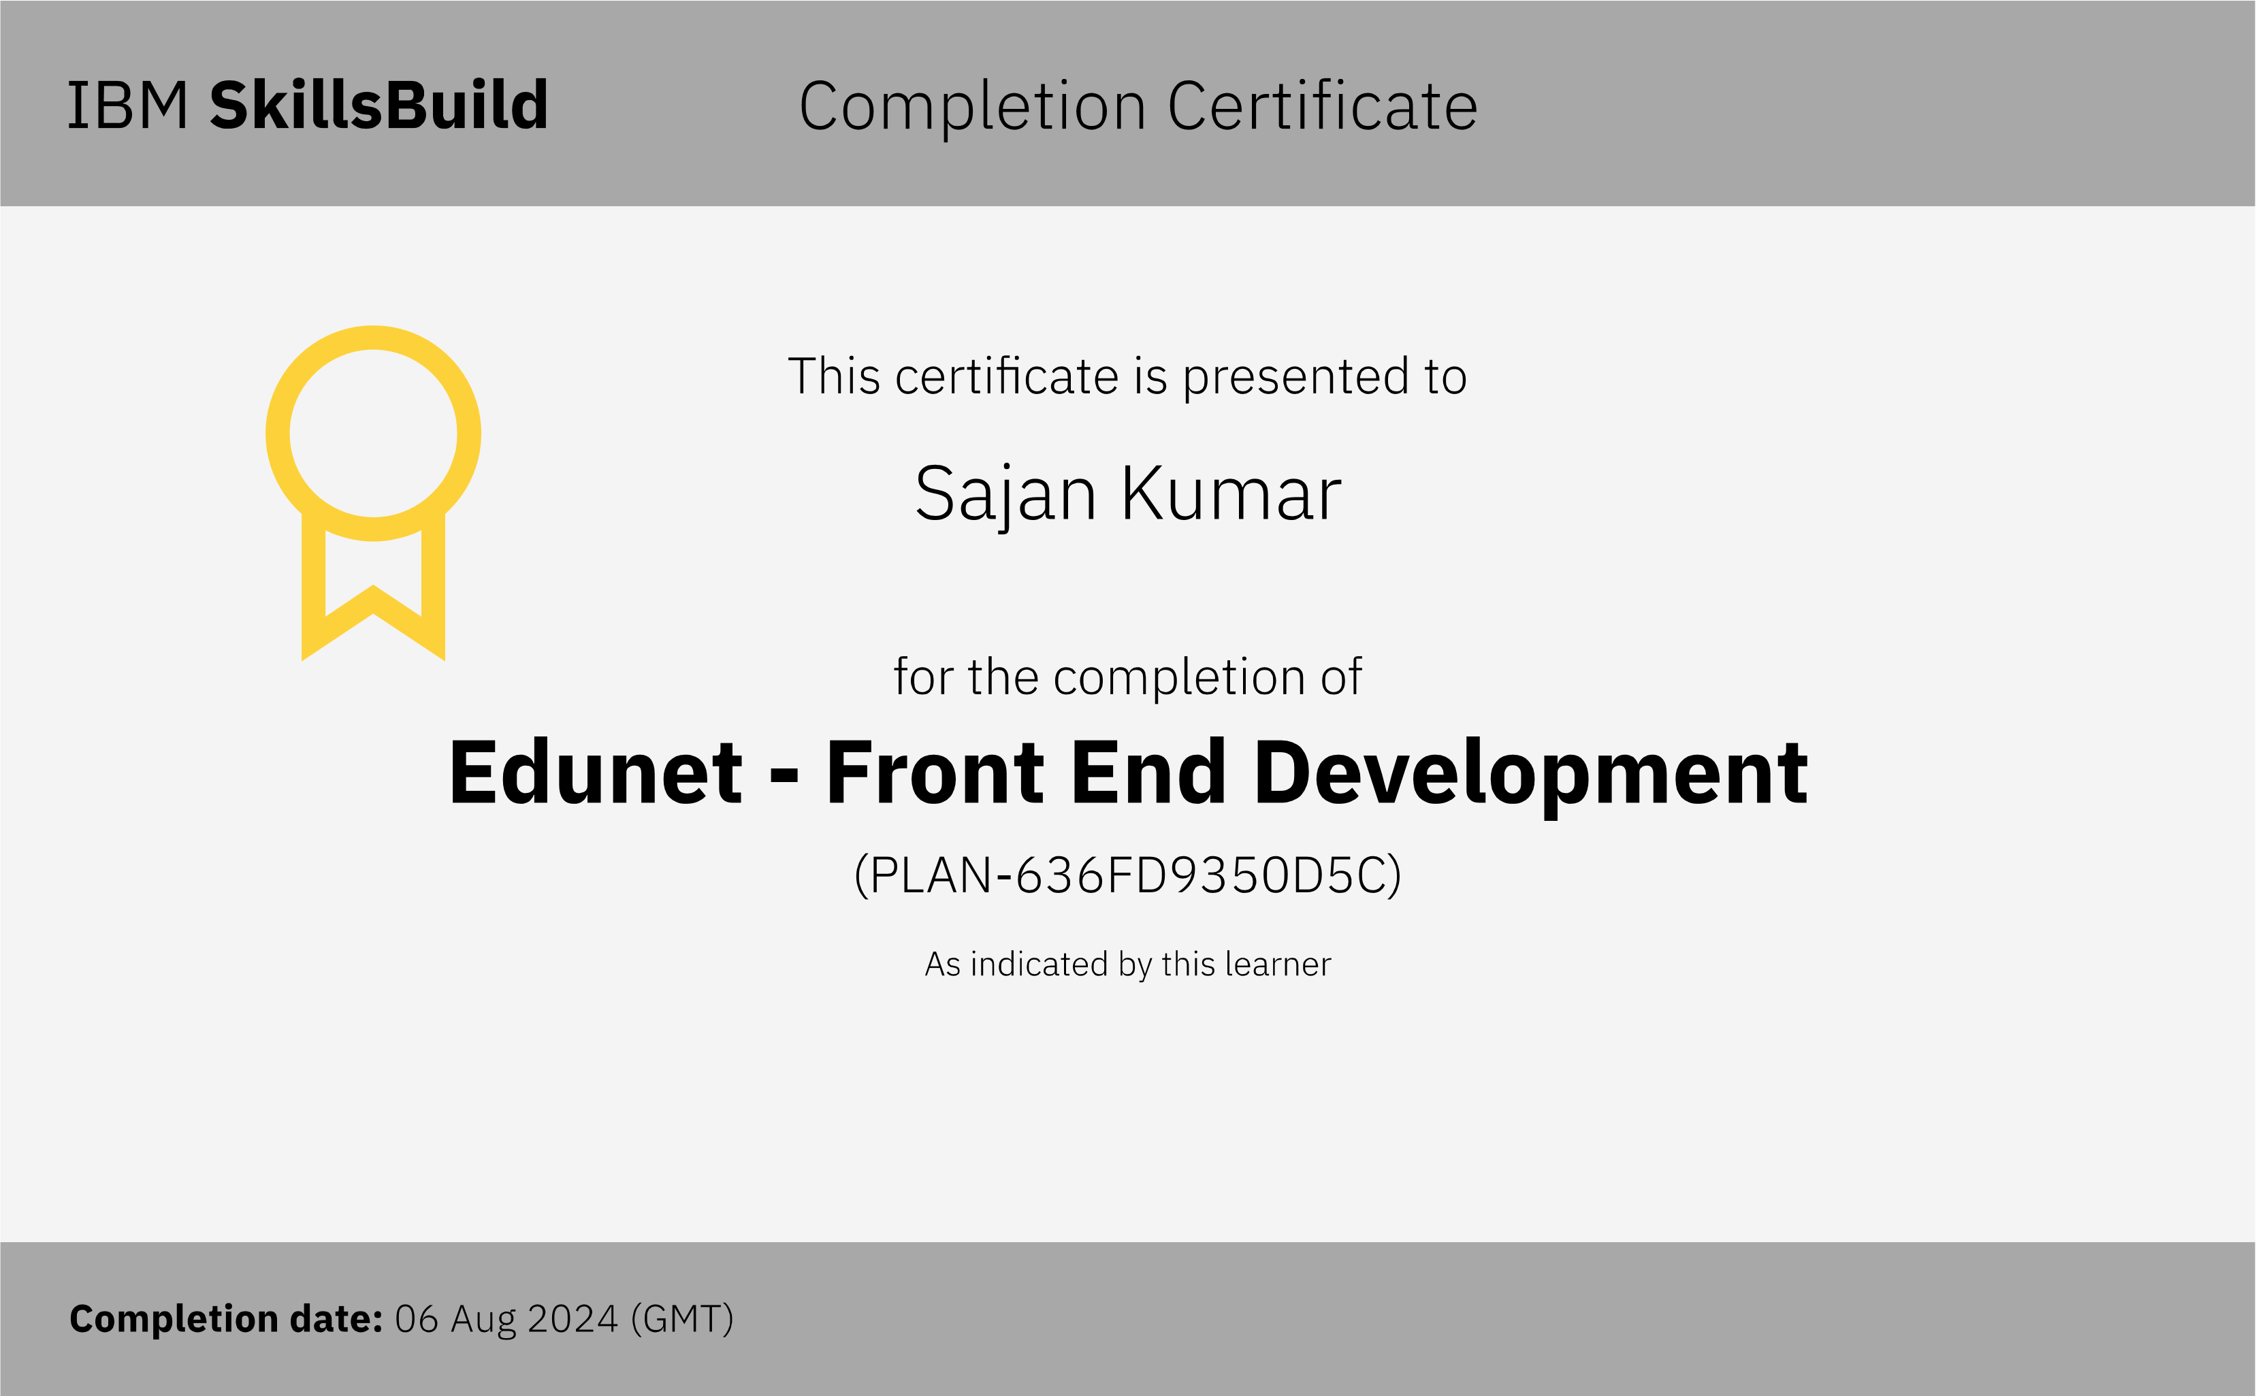
Course certificate 1

Slide 14
References
[1] https://github.com/SAJAN-8578/Int_project.git
[2] https://en.wikipedia.org/wiki/Electronic_voting_in_India
[3] https://openeducationonline.com/magazine/reasons-why-voting-is-important/
[4] https://www.geeksforgeeks.org/introduction-to-jsp/

